Slide 1

V&V of WMLES
Maochao Xiao

Slide 2
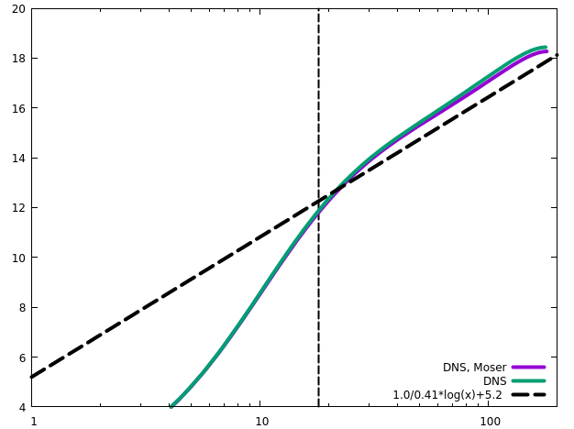
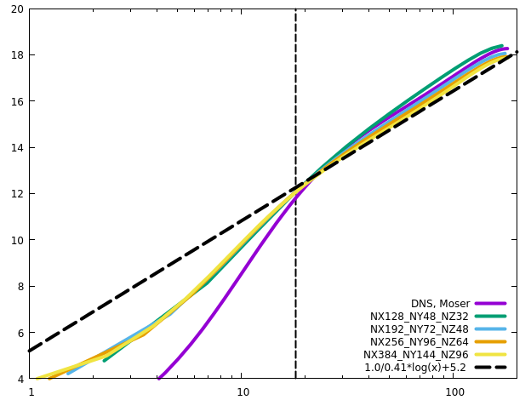
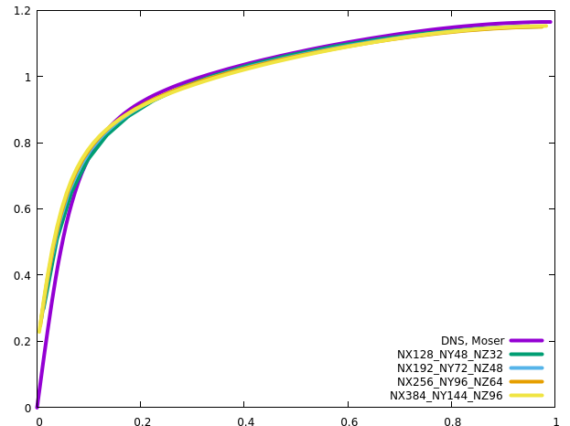
Channel
RETAU180

Slide 3
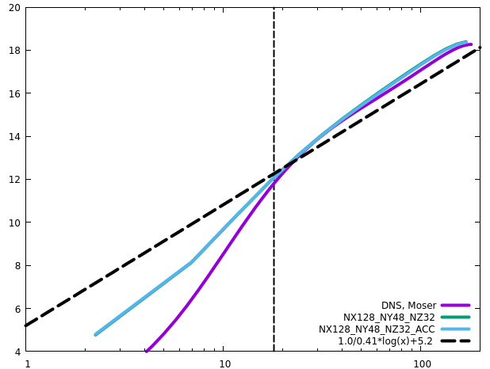
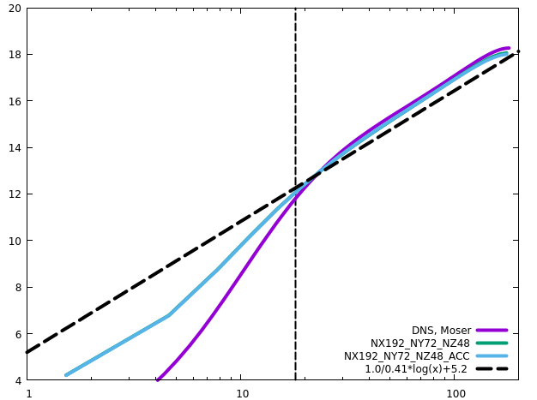
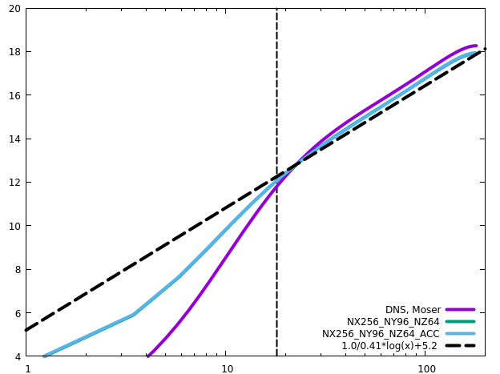
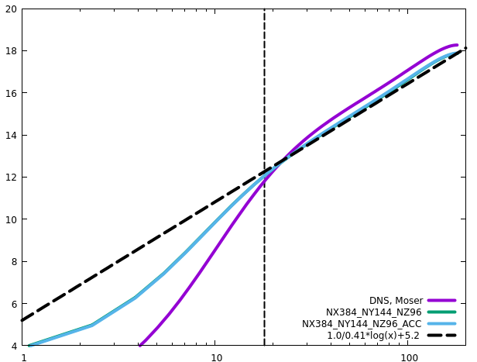
Channel
RETAU180
ACC does not influence the statistics

Slide 4
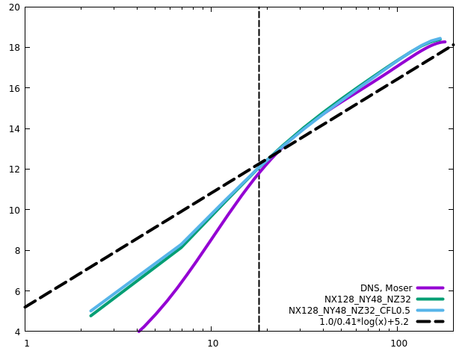

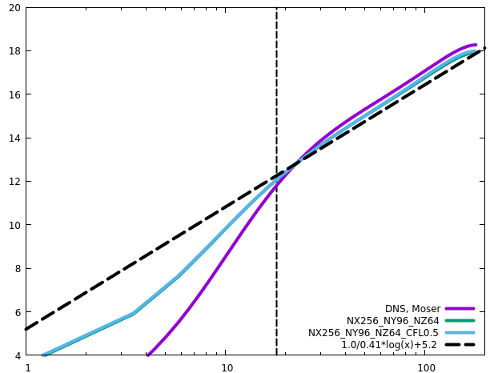

Channel
RETAU180
CFL has negligible influence on the statistics

Slide 5
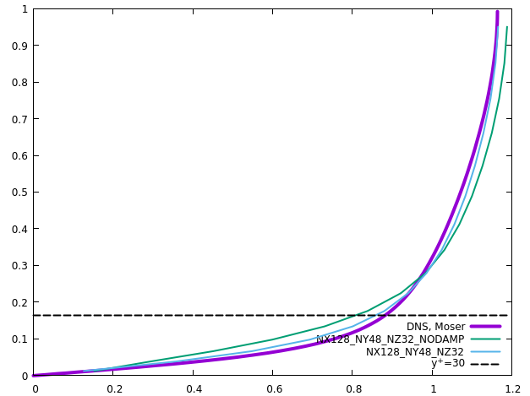
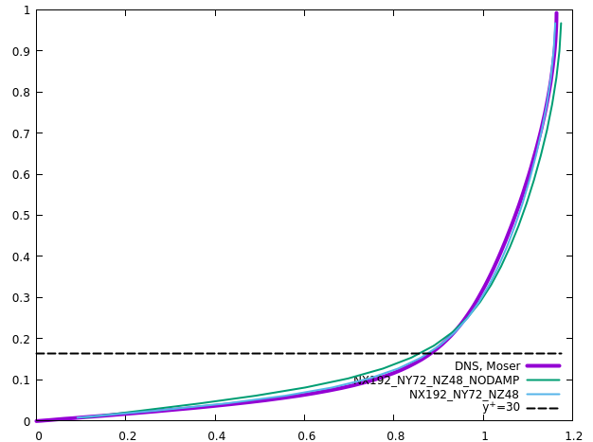
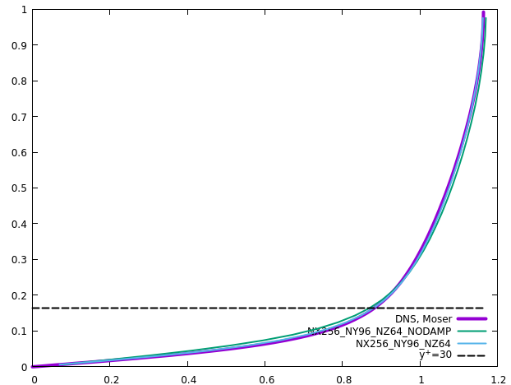
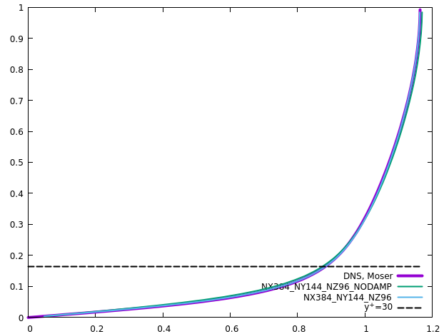
Channel
RETAU180
No-slip wall: damping produces larger (more accurate) velocity gradient near the wall

Slide 6
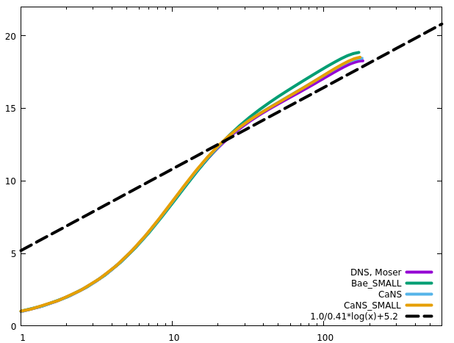
Channel
RETAU180
DNS comparison with Bae’s code. We do not expect very accurate results since the geometry and grid number are insufficient
Bae’s code produces lower wall friction. The reason is not due to time step, or grid resolutions, or domain size
Notes:
Compare with Bae’s code, RETAU180
LES+DSMAG RETAU395&550

Slide 7
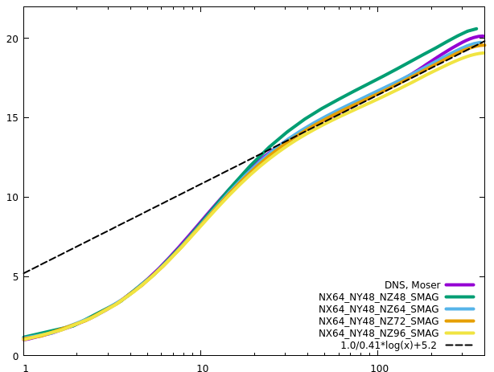
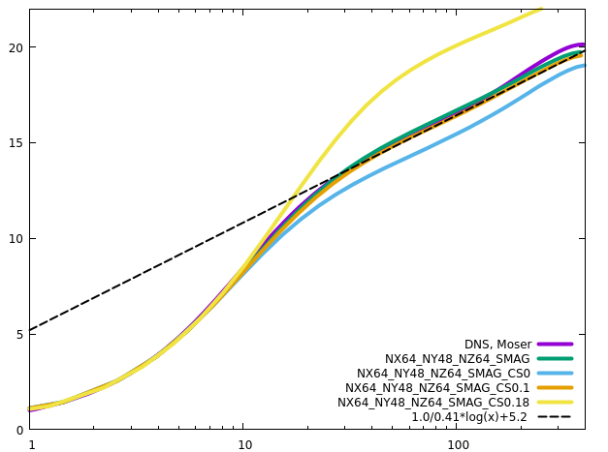
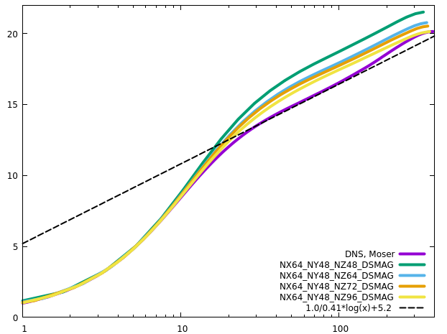
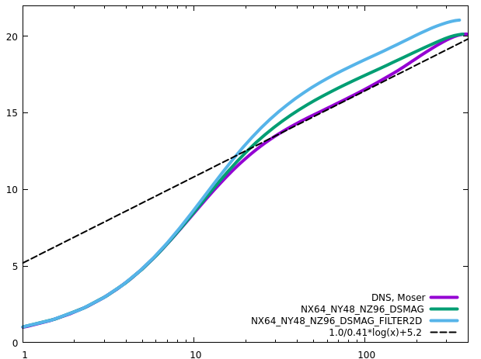
Channel
RETAU395
Similar to Orlandi’s setting (Reb=13750)
2D filter yields more dissipation, very close to Orlandi’s results

Slide 8
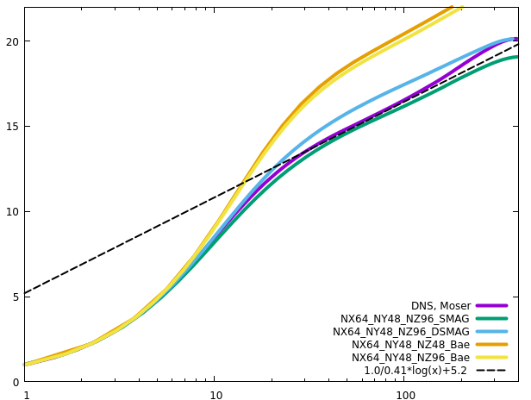
Channel
RETAU395
Compare with Bae’s code. Bae’s code is very dissipative

Slide 9
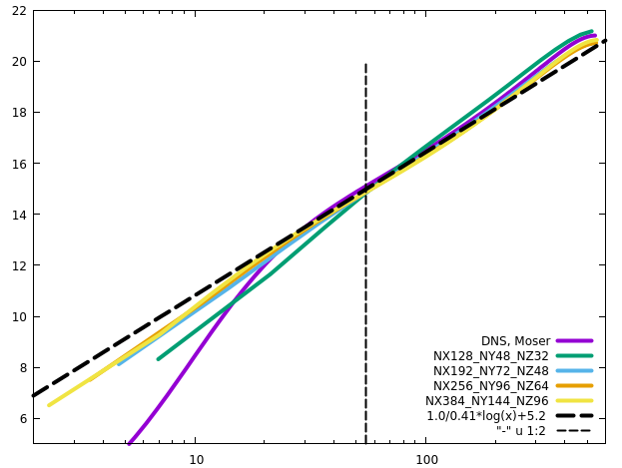
Channel
RETAU550

Slide 10
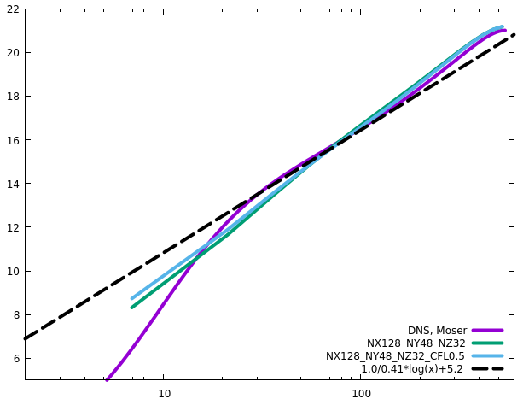
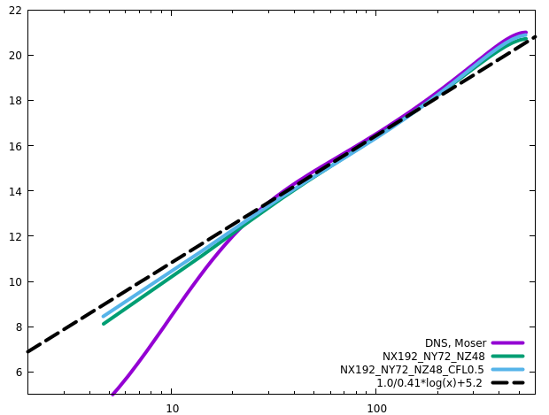
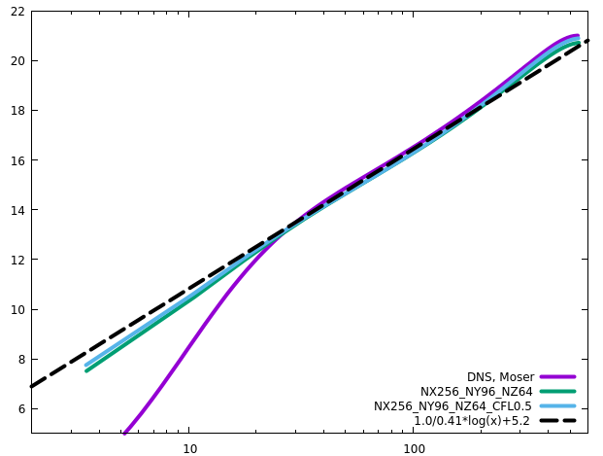
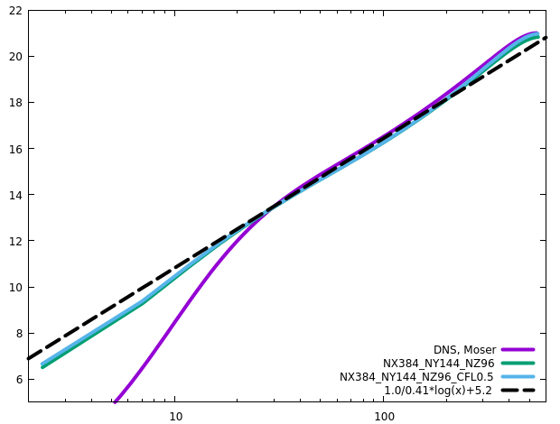
Channel
RETAU550
CFL has negligible influence on the statistics

Slide 11
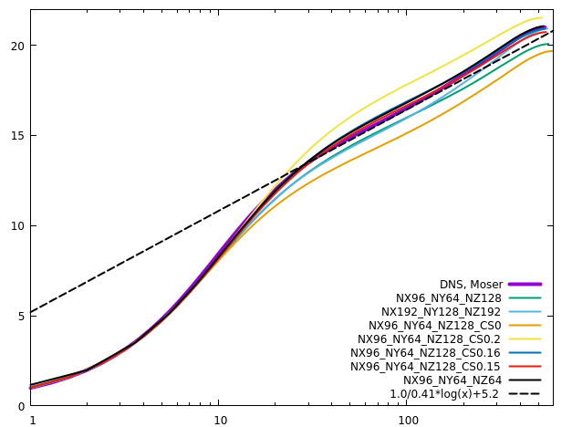
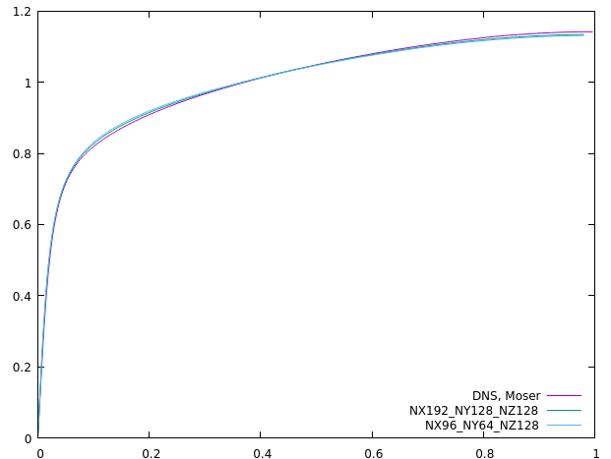
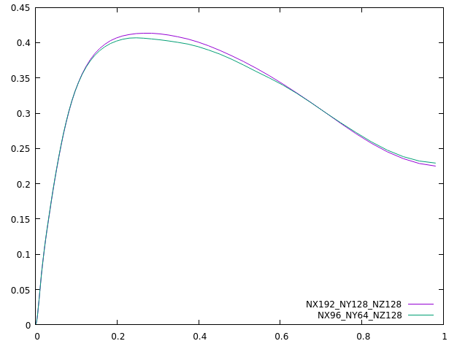
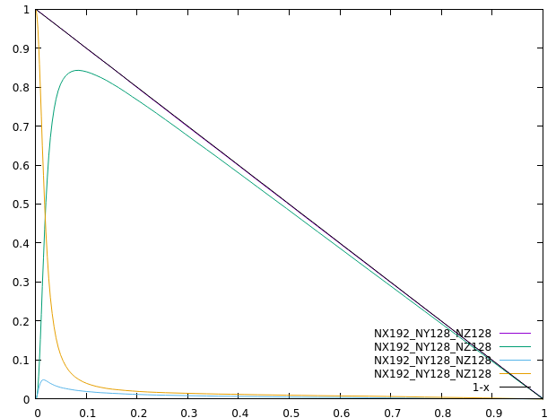
Channel
RETAU550
(Lx, Ly)=(6.4, 2.4) produces almost the same results as (Lx, Ly)=(12.8, 4.8)
CS0.16 produces the best overall results (CS0.15, best log law)
CS0.11 produces the best results with coarse resolutions in the wall-normal direction

Slide 12
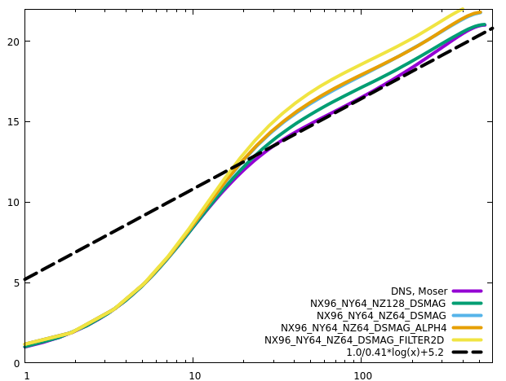
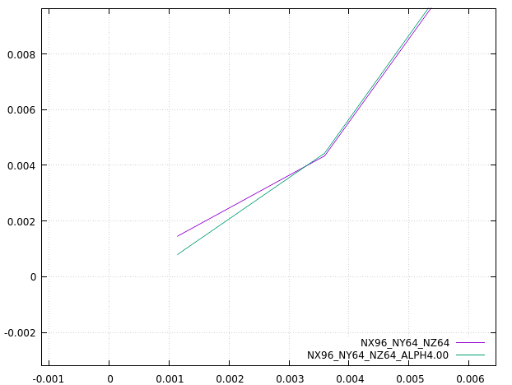
Channel
RETAU550
Dynamic Smagorinsky
Alph2=2.52 for the first off-wall layer of cells fits the first principle

Slide 13
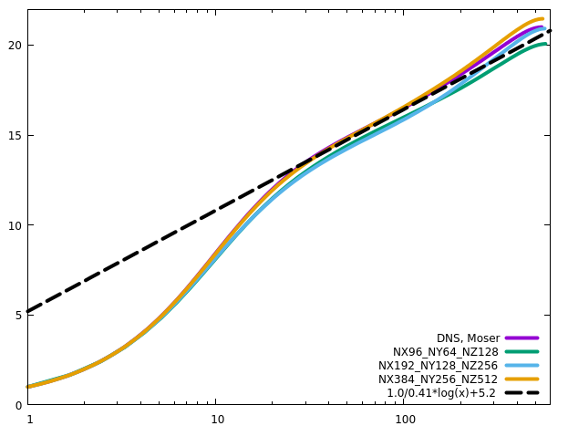
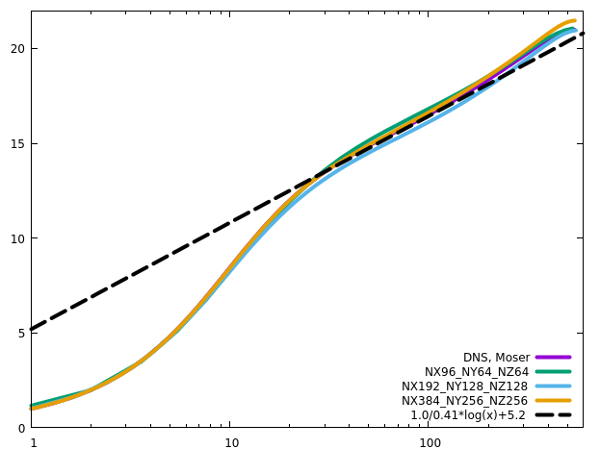
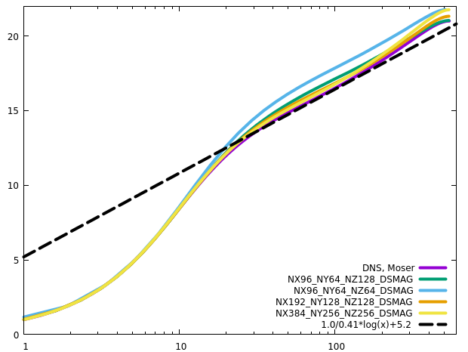
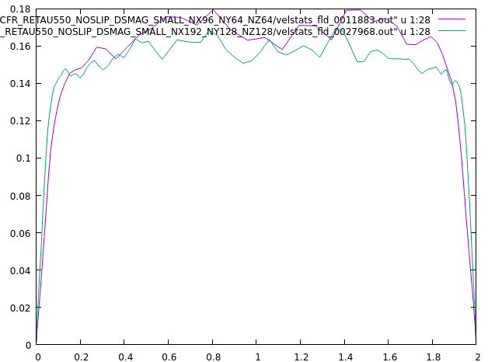
Channel
RETAU550
Grid convergence
Cs in dsmag

Slide 14
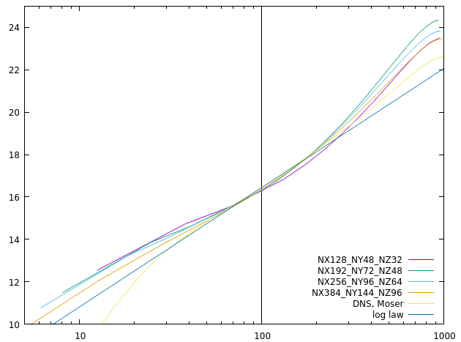
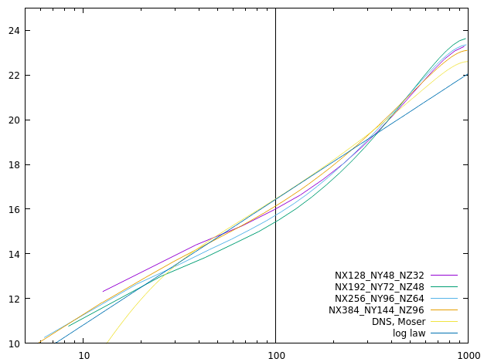
Channel
RETAU1000
Wall model
Neumann

Slide 15
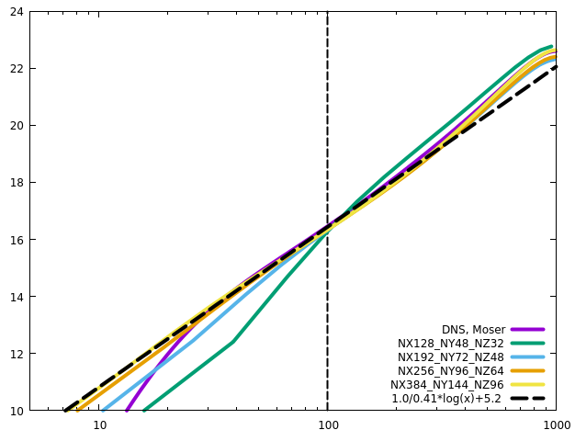
Channel
RETAU1000

Slide 16
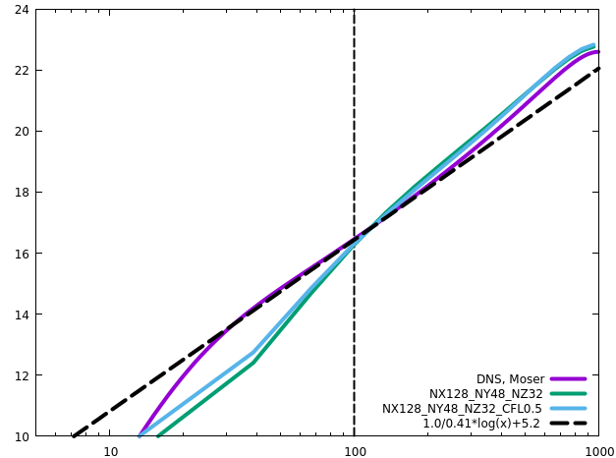
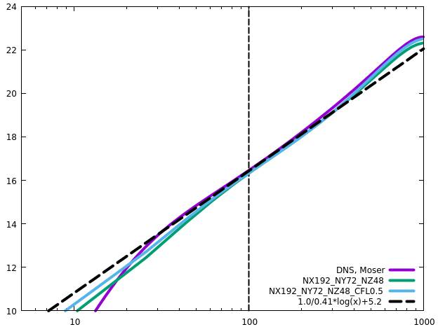
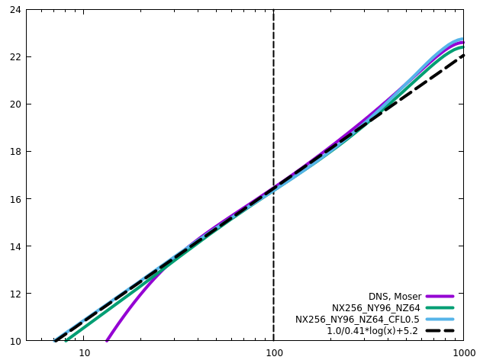
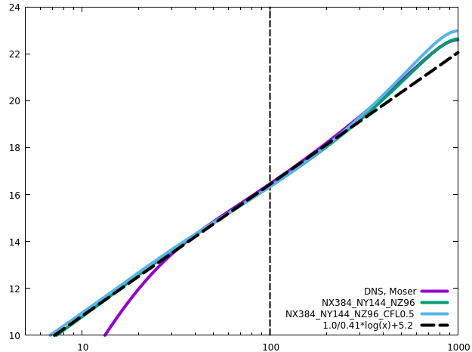
Channel
RETAU1000
CFL has influence on the statistics

Slide 17
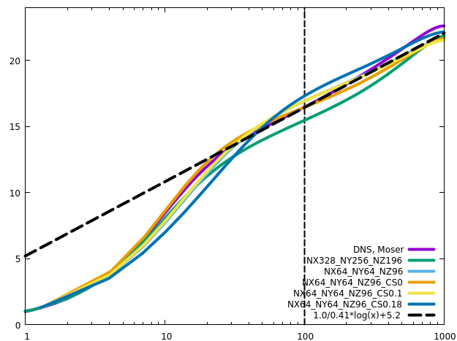
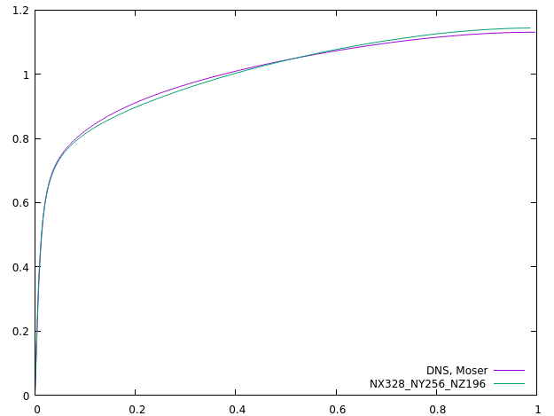
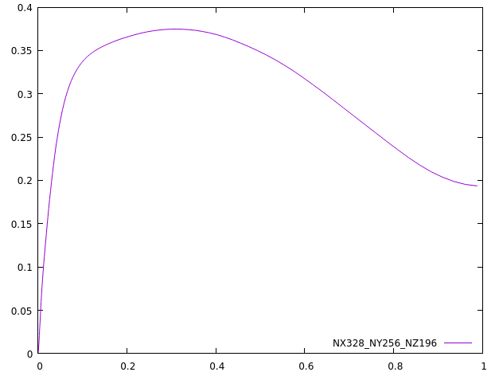
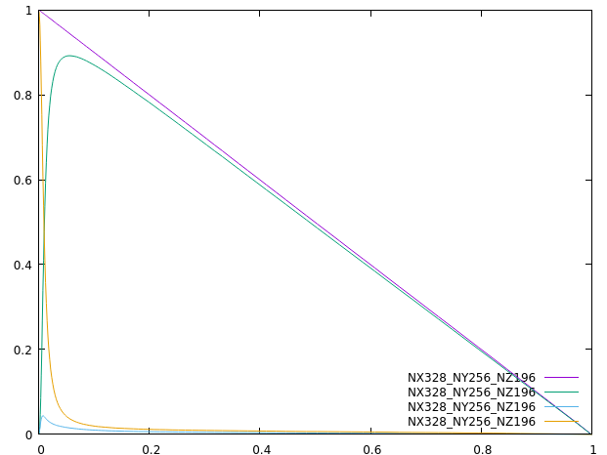
Channel
RETAU1000
Linear variation of tau_tot should also apply in LES/RANS
As Re increases, the influence of Cs is less

Slide 18
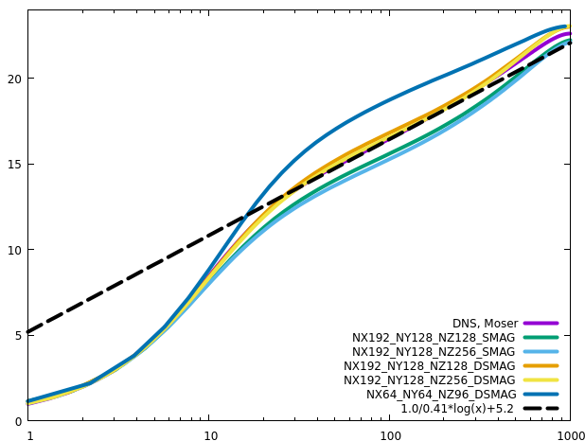
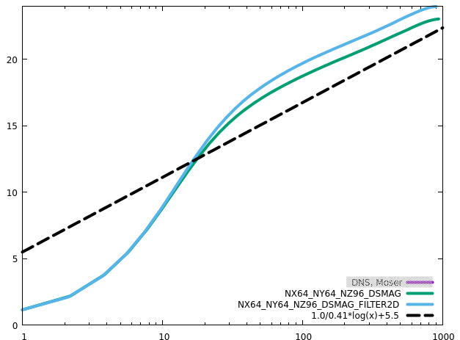
Channel
RETAU1000
Dynamic SMA produces more accurate results, than the static version, when the grid meets the requirements of LES
2D filter yields more dissipation, and the results are very close to Orlandi’s results, demonstrating that the current implementation is correct

Slide 19
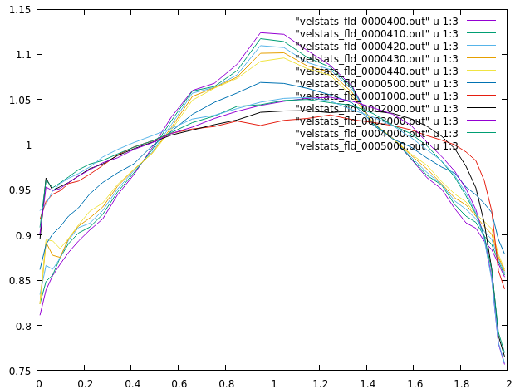
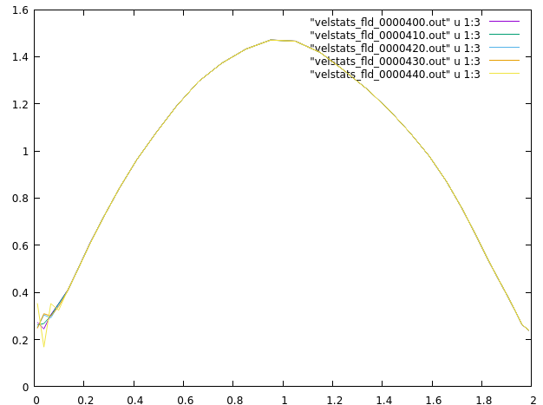
Channel
RETAU5200
First-order one-sided difference with wall model, very large (oscillating) velocity near the wall (too-small time step)
First-order one-sided difference with no-slip wall, oscillating velocity near the wall
The treatment would cause the same viscous flux for u(k=2). What would this cause?
If using second-order accurate derivative, the computation diverges
No-slip
Wall model

Slide 20
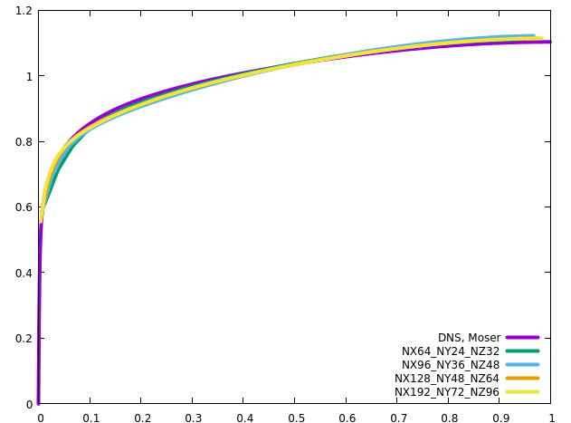

Channel
RETAU5200
One-sided differencing for strain rate at the first off-layer cells

Slide 21




Channel
RETAU5200
One-sided differencing for strain rate at the first off-layer cells
Using 2nd-order approximation of the strain rate does not bring better accuracy, in contrast to 1st-order approximation

Slide 22






Channel
RETAU5200
Using dsmag model
Setting alph2=4 brings continuous variation of eddy viscosity
AR=1
AR=2

Slide 23




Channel
RETAU5200
Compare smag and dsmag, when coupled with wall model

Slide 24




Channel
RETAU5200
Compare smag and dsmag, when coupled with wall model
Notes:
Wake region

Slide 25




Channel
RETAU5200
CS0.11 is optimal, and CS0.05 is too small, especially in the core region

Slide 26

Channel
RETAU5200
CS0 reproduces the statistics without SGS

Slide 27




Channel
RETAU5200
Domain size hardly influences the results. The outer layer is negligibly influenced
Longer domain needs longer transient time (larger structures resolved, longer periods?)

Slide 28




Channel
RETAU5200
No-slip wall: damping produces larger (more accurate) velocity gradient near the wall
No damping results in small velocity gradient near the wall due to the large eddy viscosity
Even if using no-slip wall, the eddy viscosity is too large at the first cell due to the discontinuity of wall-parallel velocity. When a coarse grid is used near the wall, the wall-normal gradient should always be computed using one-sided difference, nothing to do with wall model

Slide 29




Channel
RETAU5200
Small geometry is sufficient for testing purpose

Slide 30






Channel
RETAU5200
Grid convergence

Slide 31

Channel
Explicit vs implicit1D
The results from the explicit and the implicit1D schemes are almost the same
Neumann
Wall model

Slide 32

Channel
Explicit vs implicit1D
The results from the explicit and the implicit1D schemes are almost the same

Slide 33



Square duct
RETAU1000
DNS vs WMLES
DNS
WMLES+smag

Slide 34




Square duct
RETAU1000
DNS vs WMLES
WMLES+SMAG
DNS
WRLES+SMAG
WMLES+noSGS

Slide 35



Cavity
RE1000
DNS profiles are the same as Pedro’s profiles

Slide 36



Cavity
RE1000
DNS with wall model
DNS
DNS+WM

Slide 37


Cavity
RE1000
DNS with wall model

Slide 38


Moving frame
RETAU180
DNS on the coarse and fine grids

Slide 39

Moving frame
RETAU180
DNS with wall model on the fine grid

Slide 40

Moving frame
RETAU5200
DNS using WMLES grids

Slide 41

Moving frame
RETAU5200
WMLES

Slide 42




DIT
SMAG
LES

Slide 43




DIT
DSMAG
LES

Slide 44

y
(periodic)
x
z
(periodic)
(periodic)
L$=9×2π cm$

Slide 45







Slide 46



$$L_{z}=4.8h$$
Wall
y
(wall)
x
$$L_{y}=2h$$
Wall
z
(periodic)
(periodic)
$$L_{x}=12.8h$$

Slide 47




$$L_{x}=12.8h$$
$$L_{z}=2h$$
$$L_{y}=2h$$
Corner
bisector
Wall bisector
Corner
bisector
Wall bisector

